Slide 1
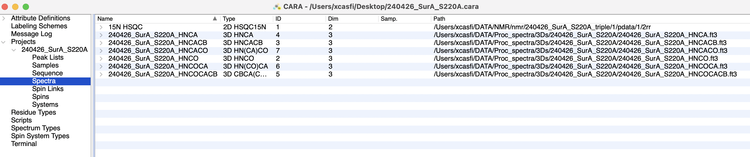
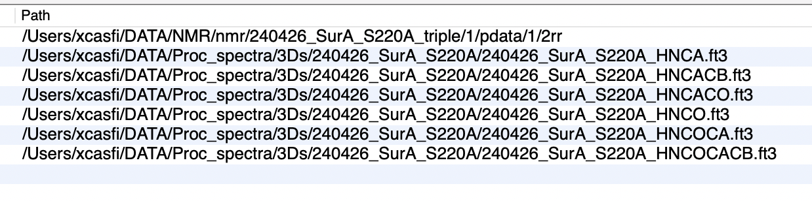
INITIAL PROJECT PSEUDOCODE
Script to change the directory in a ”text” file to facilitate the use of CARA program.
With this script I want to replace part of the directory from the person I receive the file from, to the directory where my file are located, maintaning the last file name.
REPLACE
KEEP

Slide 2
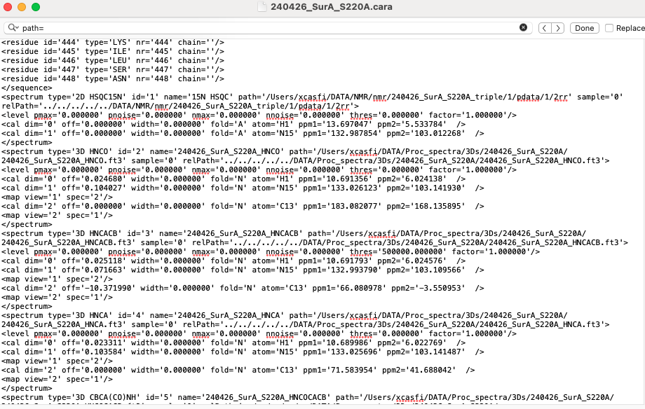

Slide 3
Pseudocode
Open the file
Set variable ”new path”
Create list “original”
Create list “replace”
For loop over file
Search for ‘path’
add path to list “original”
For loop over that list
find if they exist
If they exist, remove from list
Split by / into secondary lists
Add ”new path” + last item of sec list to list “replace”
Loop over length in list “original”
search for “original” and replace with “replace” at position i
Save as new file

